Slide 1



E-commerce Website
E-MART
Guided By:-Prof Ronak N. Patel
Prof Martin Parmar
Prepared By:-Joisar Sujal -21CE046
Nishar Khorajiya-21CE057
U & P U. Patel Department of Computer Engineering

Slide 2
Overview:-
Project Definition
Project Description
Objective
Major Functionalities
Technologies used in projects
Requirements
Future Work
Snaps
References

Slide 3
Project definition
The business-to-consumer aspect of product commerce (e-commerce) is the most visible business use of the World Wide Web
An e-commerce platform is a software that enables the commercial process of buying and selling over the internet.
This website is for those Minor Business Sectors who want to sell their products online and Buy Products at least price and Best Quality.

Slide 4
Project Description
This project deals with developing an e-commerce website for Online Product Sale. It provides the user with a catalog of different product available for purchase in the store.
In order to facilitate online purchase a shopping cart is provided to the user.
Any Member can register and view available products
Only registered member can purchase multiple products regardless of quantity
Contact Us page is available to contact admin for queries.

Slide 5
Objective
The primary goal of an e-commerce site is to sell goods online.
The Second Moto Behind this website is that Middle Class person and Minor Industries can buy as well as sell anything from mini product to large product very easily at best price and good quality .
it is User-friendly Website.

Slide 6
Major Functionalities
Register
Login
Select Any items from Given Products.
Add to Cart
Bill Page
About us
Contact us

Slide 7
Technologies used in Project
Frontend:-
Html(5)
CSS(4)
JavaScript(18.2.0)
BOOTSTRAP(5)
Backend:-
MongoDB(6.0.)
Nodejs(18.0.0)

Slide 8
Requirements
Software
Vs Code
Chrome Search Engine
Hardware
Processor : intel core i5
Memory(ram) : 8GB

Slide 9
Future Work
The Users who want to sell their products through our website they can sell it and gain profit from us.
Add to Cart Functionality
Payment Gateway
Search Functionality

Slide 10
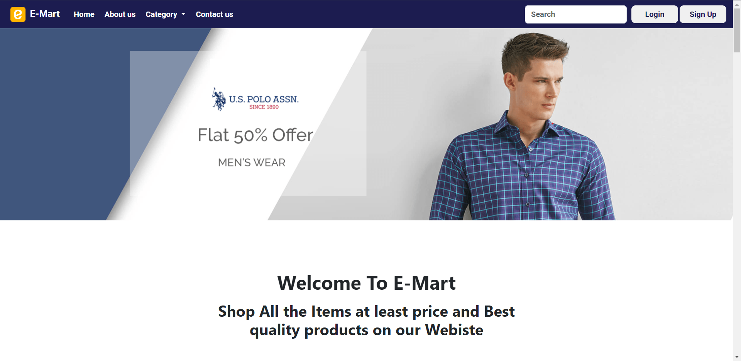
Home Page

Slide 11
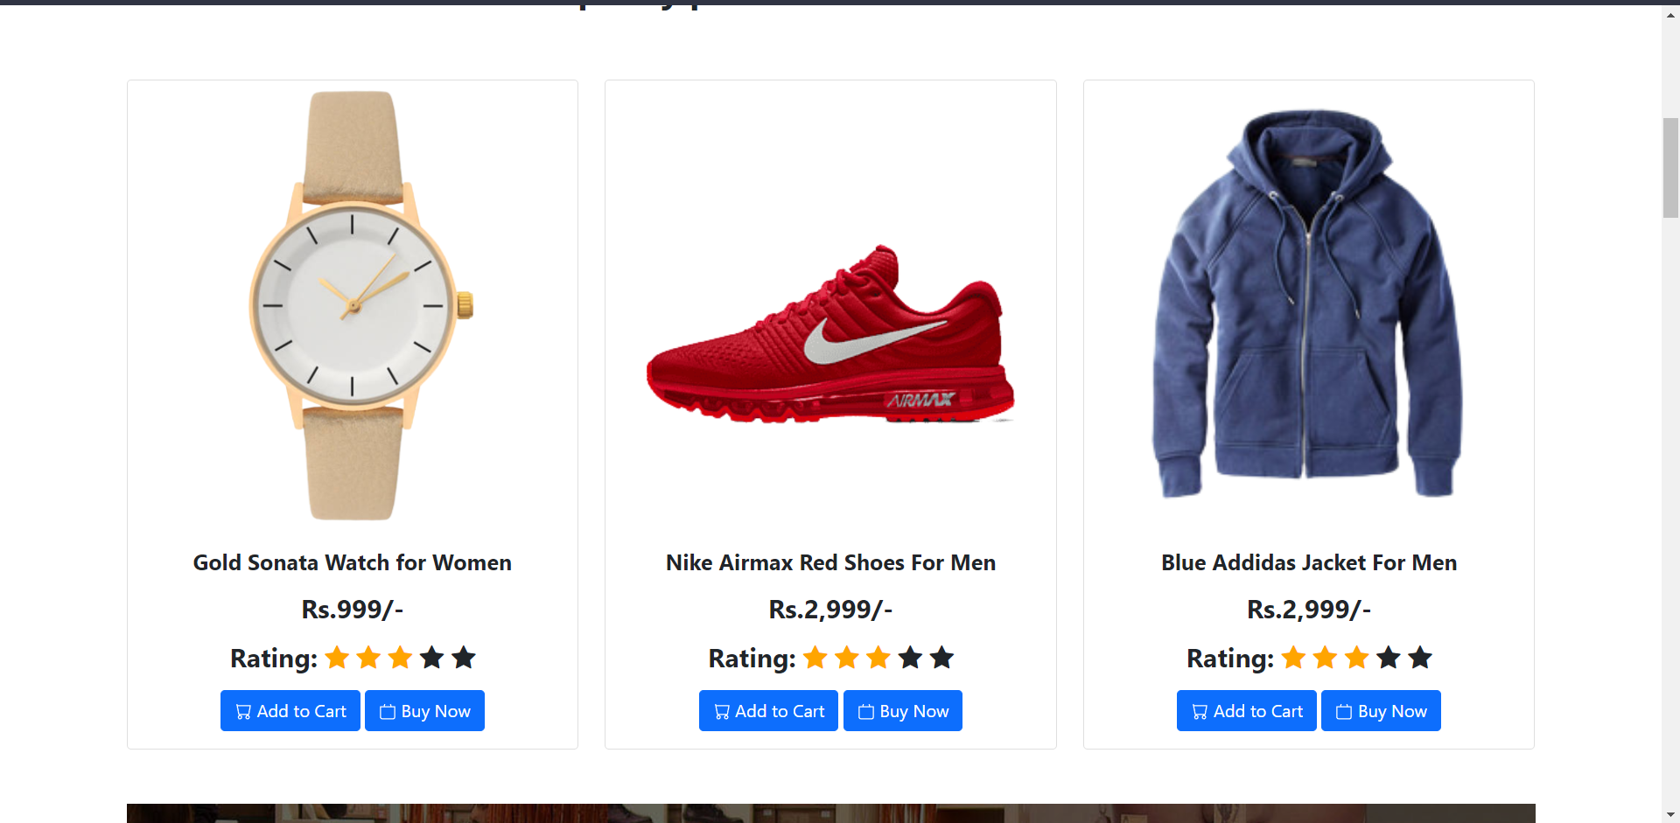
Home Page

Slide 12
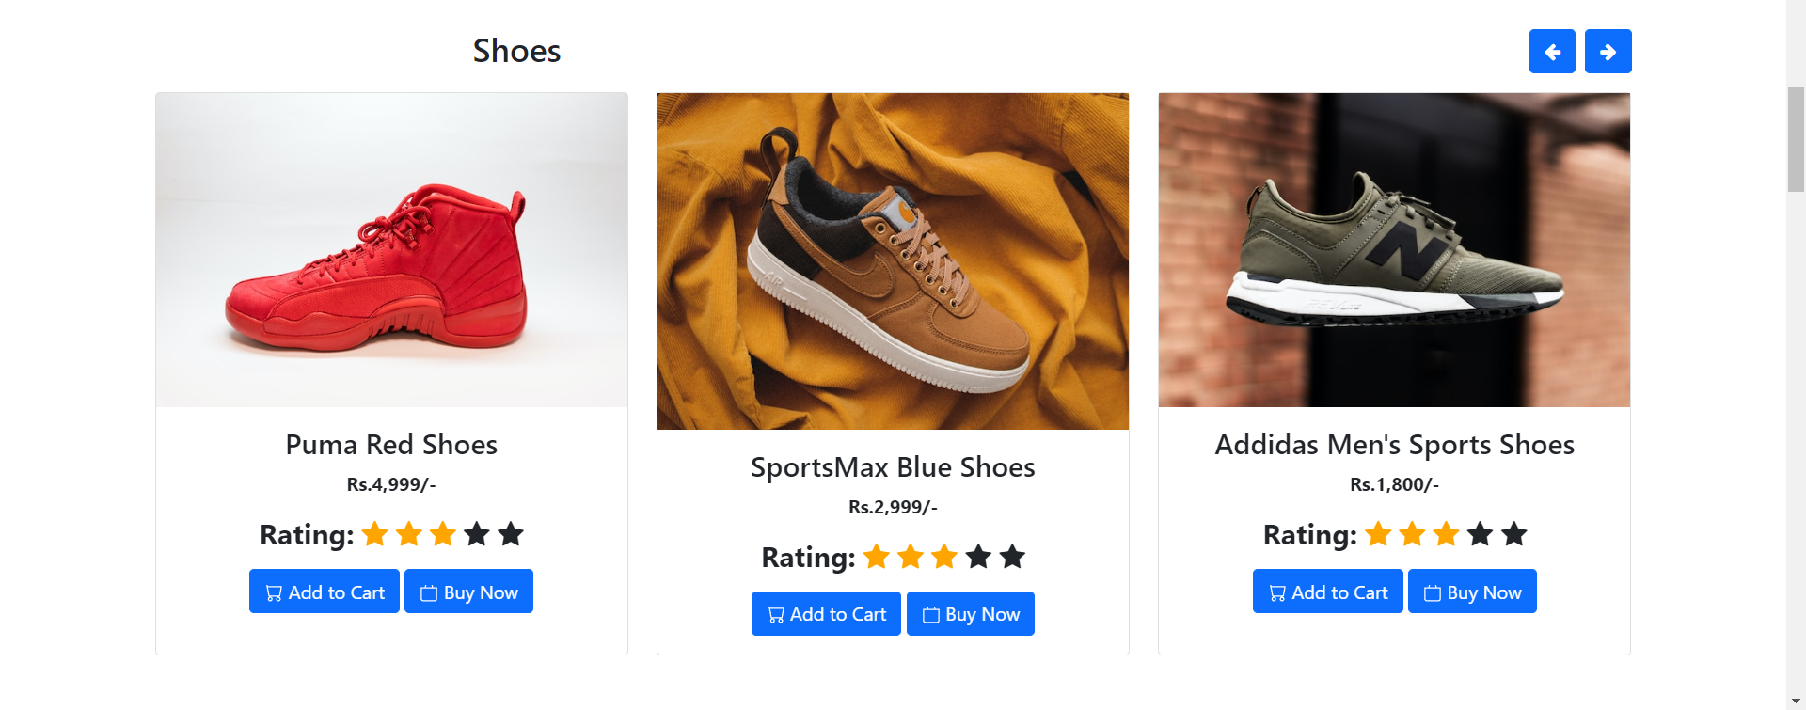
Home Page

Slide 13
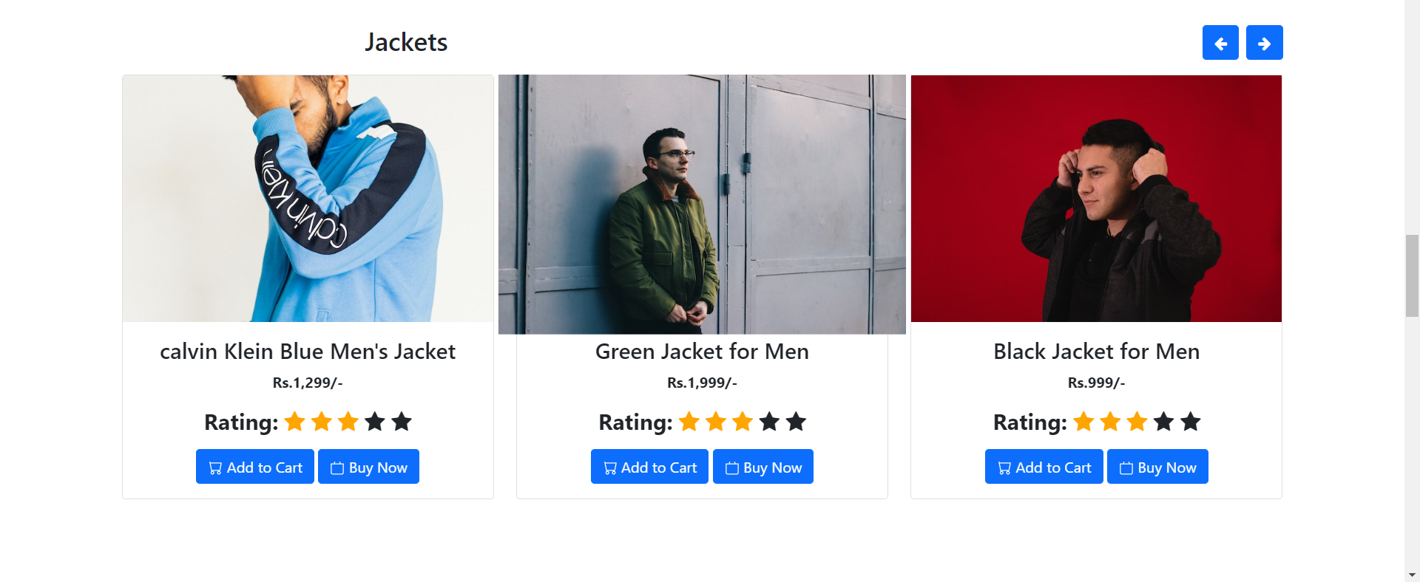
Home Page

Slide 14
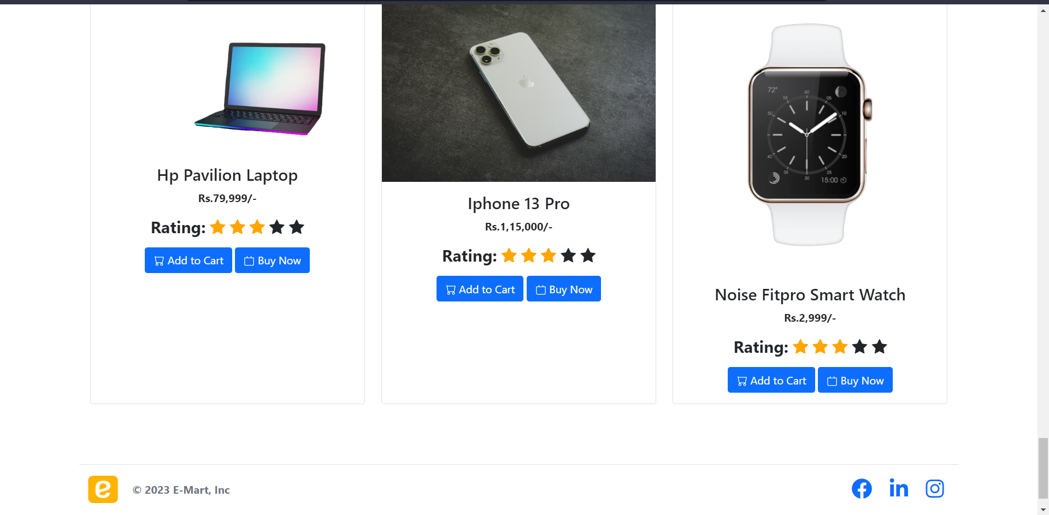
Home Page

Slide 15
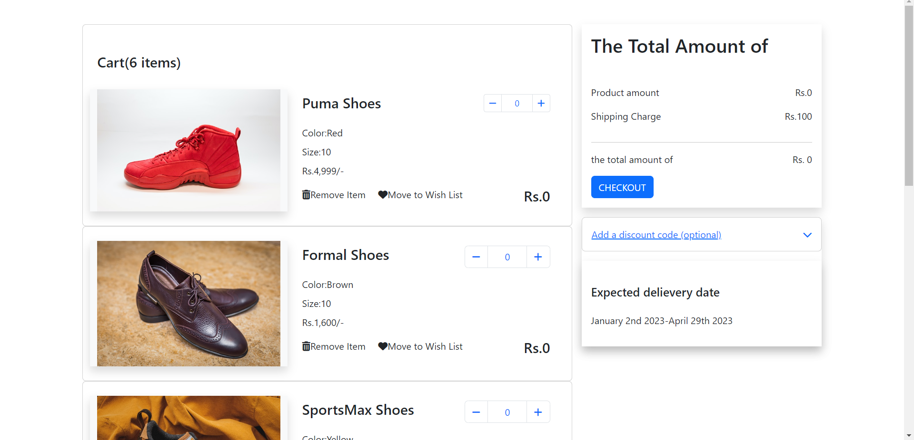
Add to Cart

Slide 16

Login

Slide 17
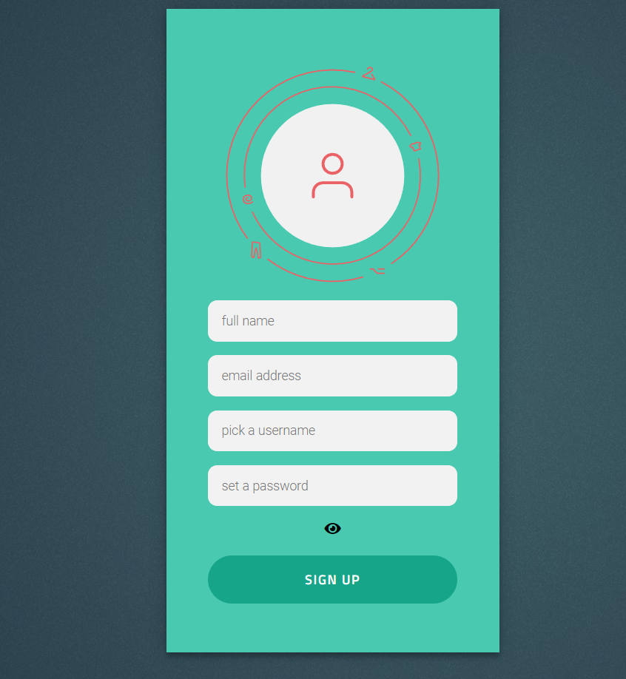
Signup

Slide 18
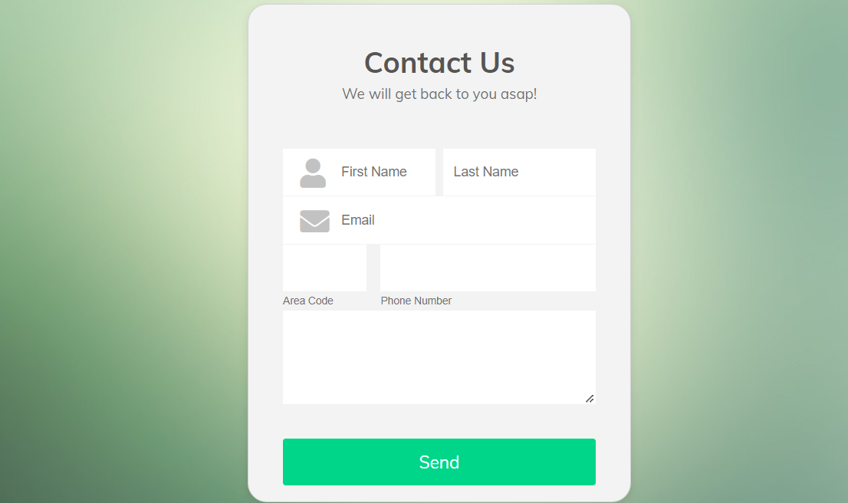
Contact Us

Slide 19
Reference
https://www.youtube.com/watch?v=yfpoT0YKSIc
https://www.youtube.com/watch?v=2DUJvbw6jTA

Slide 20
THANK-YOU

